Slide 1

Knock. Knock. Who’s there?
A message from the future
Notes:
Sometimes there are days I wish I could turn back time and undo some things to pretend they never happened. Almost like git rebase for time.
1927 a British astronomer called Arthur Eddington came up with a concept called “arrow of time”. The concept he posited described the time as unidirectional or asymmetric or always flowing in one obvious direction. But we don’t have to be fancy astronomers to grasp the concept of time
We all understand quite early in our life’s that time is constantly flowing in one direction and there is no turning back. Except when we implement time based business requirements we have a tendency to look back in time and believe that’s the only way to go.
Today I will take you through a journey of time and explore how traditional approaches sometimes fail, what alternatives we can leverage and how we can use durable timeouts to predict the future.
But first I have some shocking news for you

Slide 2
Business logic tends
to be complicated
Notes:
(click)
Thanks Captain obvious for this piece of advise
(click)
Jokes aside when working with clients I see people end up making the same kinds of mistakes repeatedly or more accurately the symptoms are the same.
The way that people make mistakes is very different each time so most of it has to do with business logic, so with regards to business logic.
I think it's fair to say that all of us in our systems have some kind of complicated business logic. But I want to talk about a specific kind.
The kind that involves both commands and queries.
So who is a part of their business logic: sometimes has to look up some additional data?

Slide 3
Hiding
Inconsistencies
Notes:
And it turns out that in that area that when you have your most complicated business logic, which often gives the business. The greatest value. That's where we actually have consistency problems that are hiding.
And this is irrespective of whether you're using Command and Query Responsibility Segregation (CQRS) or not.
Even if you're using a fully synchronous end to end architecture talking to a fully transactional relational database.
These things can bite you
So a lot of times everybody's heard about this eventual consistency.
you can go use it . Mongo web scale and all those kinds of things,
but a lot of organizations say, well, we'd rather Keep it safe and stay with the things that we know
I'm here to tell you is that even when you're using this safe architectural choices of doing everything synchronous even when you're using the safe technology choices like using SQL server. Oracle even then, sometimes you could end up with an inconsistent system.
These inconsistency problems get aggravated in multi user collaborative systems

Slide 4
Multi user collaboration
Notes:
The always on perpetually working your lots of users in parallel type of system has become more and more ubiquitous
users expect to be able to access their data. Whenever they want wherever they want and it's not just
each user by themselves. When you have a situation where you have users that are only operating on their own data.
Life is actually pretty simple I call those types of systems that are multi single user systems.
They're kind of like a multi user system, but each user's kind of in their own little data and that's it.
It's when users are able to touch each others data that things start to get even more interesting.
Now. Unfortunately, when we look at not just the technologies that we're dealing with, but the programming practices and the paradigms a lot of them are based on that same object oriented thinking Well, you write objects and you persist.
These objects in some kind of database and. It works or at least it works on your machine
pretty well. Then you put it in production in some kind of problems happen.
Usually the way that we address consistency concerns when we
have multiple users operating on the same set of data is using things like optimistic concurrency who's heard of optimistic
Concurrency?
So we got our traditional first one wins in last one wins concurrency where first one wins means first user that get in get
their changes done last one has to redo their changes.
Sometimes this gets even more interesting when we jump into a user and themselves.
And the users table to do things relatively quickly.
So let's jump right into code.

Slide 5
Frontend
Backend
Database
ASP.NET CORE
Front
Back
Storage
Orders
Read / Write
HTTP
ADO.NET
Notes:
Demo 1
The most traditional innocuous type of domain object that you’ve probably seen the order object everybody when giving some sort of presentation always reverts to retail. So boring as I am I will follow that.
Briefly explain
Switch to code

Slide 6
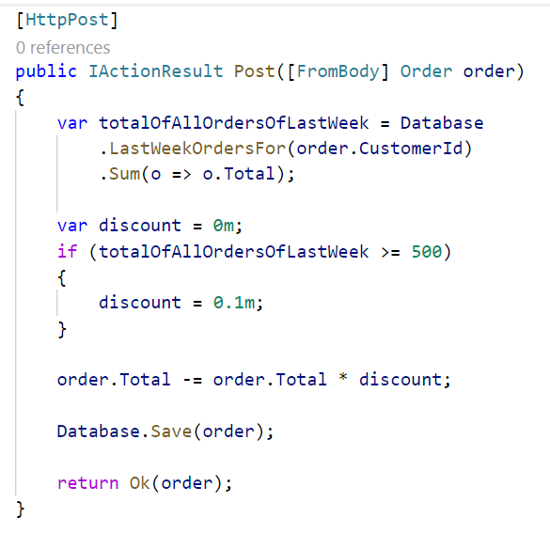
Notes:
Now this order controller is implementing some. I wouldn't call this complicated business logic, but we got a new business requirement that says as
a part of processing a new order. We want to decide under which conditions a customer is going to be getting a discount now.
The customer that is submitting this order in the past week did more than $500 euros Swiss Francs Norwegian kroner Swedish kroner Danish kroner whatever your currency of choice. Then they get a discount. And if not, they don’t.
Your average developer looks at the requirement implements this code doesn't really think twice checks that it works
The area where things become a little bit tricky is what happens if it’s 2 or more users.
But the customer in essence is an account and we can have multiple users from the same account buying stuff on the same account. So we have two or more users at the same time, both of them are submitting an order.
Run demo
Alright so imagine 2 threads going through that logic at the same time, where the last week of orders was $300.
Each of them is submitting a new $300 order.
Both of the logic goes down to the database. Both threads go to the database take a look at all of the existing orders.
Oh. No, we've only got $300 worth of orders

Slide 7
And then the customer walks into your office
Notes:
For one of the order the customer didn’t get a discount. You can imagine this gets worse the more concurrent requests we get from the same customer. Where if these users just made their requests a couple of seconds apart, then one of them would have gotten a discount.

Slide 8
Notes:
Now that's not a very nice thing to do when you think about it, I mean, ultimately, we are penalizing our users.
For this type of behavior for purchasing too quickly.
How we ended up here to begin with? So this idea about processing these types of things in real time before that, we had the good old solutions. For any kind of data crunching we wrote our good old batch jobs

Slide 9
Frontend
Backend
Database
ASP.NET CORE
Front
Back
Storage
Orders
Read / Write
HTTP
ADO.NET
Scheduler
Notes:
Demo 2
Something that would run nightly back somebody comes along Yanks,
a lever and the machine starts humming.
And if it goes to the database and a whole bunch of stuff.
Here's a code that might look like something like that,
Switch to code

Slide 10
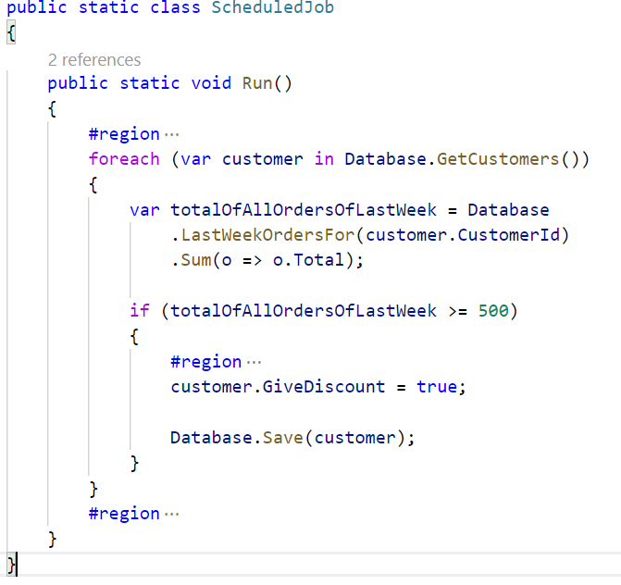
Notes:
so we've got some customer object that has a method
that's invoked in the nightly batch and what it's doing
is fairly simple just going and looking up.
These types of orders and then saving some sort of
flag on the entity.
Doing Alright this customer now should be given a discount.
The problem with that is that we have this sort
of reset problem.

Slide 11
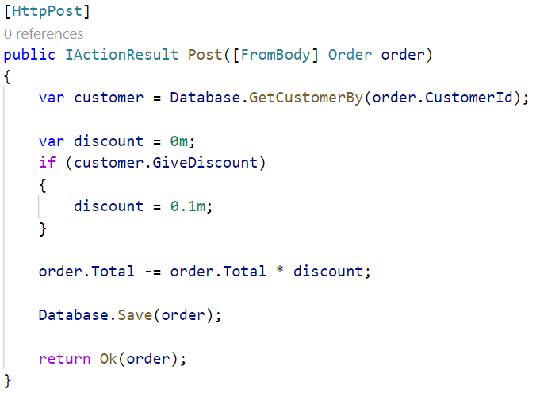

Slide 12

Rethink time
Notes:
A lot of our traditional domain models in a parallel
collaborative type of world are defective by design.
Thing is we can do better.
We can do a whole lot better,
but it requires us to think about software and think
about requirements in a slightly different way so.
The hinge in dealing with software in parallel type of
software is exactly that it's that concept of time.
It's rethinking the arrow of time and how we program
with it.
So the traditional requirement that we said was Alright.

Slide 13
t
1 week
Sum(o => o.Total)
Notes:
We've got this stream of orders that are coming into our system. And whenever we get an order we look back in
time, 7 days or whatever the requirement is sum up.
The total value of orders in that period of time and if the value is greater than 500 and some odd dollars.
Then they get a discount and we mentioned the problem was if we have 2 things happening at the same time, we can end up with an inconsistent value.
We can achieve the same result instead of looking backwards in time looking forwards in time.
Which seems a little bit unusual?
How can you predict the future thing is you can’t predict the future but you can?
Fold the future into your programming now and let me explain how you do that logically so when we get an order ultimately what we're interested in is the last 7 day. Total instead of calculating that.
You know at the time of the order.
We can turn that around and say actually let's introduce that concept into our domain itself.
A customer has a 7 day running total of orders because ultimately that's what the business is telling us it’s talking about the last 7 days?

Slide 14
t
WeekTotal
WeekTotal
+= o.Total
1 week
-= o.Total
+= o.Total
1 week
-= o.Total
+= o.Total
1 week
-= o.Total
Notes:
What we're doing is we're just making that explicit so
when we get $300 order?
What we're saying is Alright.
The 7 day running total is $300 but.
That needs to be decrement, in 7 days in the future.
In essence, we want to send data to ourselves 7 days from now saying, You know you need to decrement.
The 7 day running total 7 days from now.
And as we get this dream of orders that are coming in and we say OK now we increment it by $300 now.
And we throw information into the future, and saying decrement it by another $300 then.
And as we keep on going you aggregate the data that we need so that we have a current running total.
That's telling us OK. Now it's $300.
Now it’s $600 etc. And as we catch up to ourselves in time.
Then we need to have that kind of wake up call saying Hey look.
It's been 7 days since order number one say,
Oh, OK, then what I need to do.
Is to decrement it down to 300 OK?
It's been 7 it's been 7 days since order number
2 Alright.
Let's decrement that one down as well.
The difference here is that like I said instead of looking back in time. We look forward in time.
So as we're modeling this as new orders are coming in. We're doing. That same type of behavior over and over
and over again, so that when we finally arrive at a specific order.
We're not actually doing a query.
We're not doing historical look up.
But rather we've folded the history into our current state.
But we've done that in a highly consistent way.
The reason that we've done it in a highly consistent way is that what we've done is we've in essence
created call it an upside down anti-batch job.
So remember the code that we have with our bad job where we said no over here, we're going to have a customer.
That has some sort of give discount equals true value.
We rolled up some state and we put it in the customer. We're doing the same thing here.
We're rolling up some state and pudding it in the customer. The important thing is that when we're dealing with a
customer or something like that? What we can say is well. Now we have a specific entity that has specific data.
This is one row. In the database. Databases can guarantee us full transactional consistency at the level
of a single row.
Others if we have 2 things that are happening at the same time,
one of them wants to submit a new order and
another one is dealing with a timeout.
Then ultimately that bid is going to lock on that
single row.
That, in essence is the trick of an aggregate root
to design your logic in such a way that all
transactions are touching just a single row a single entity.
However, in terms of programming this requires something that we don't really have.

Slide 15

Program time
Notes:
An you know system threading timer.
Not such a good idea is it.
The problem with those types of in memory timers is
that if our machine crashes.
Well, it won't remember that,
it needs to decrement the value in 7 days.
So we need a highly reliable durable transactional way of
dealing with time,
so that no matter what happens in our system.
We won't lose that information.
Once we have all of this kind of stuff then
will be in a situation where you can say all
right now, we can build real aggregate roots.
One way of achieving that is to leverage our durable scheduler that we might already have in place from the good old days of executing batch jobs

Slide 16
Frontend
Backend
Database
ASP.NET CORE
Front
Back
Storage
Orders
Read / Write
HTTP
ADO.NET
Scheduler
Notes:
Demo 3
Switch to code

Slide 17
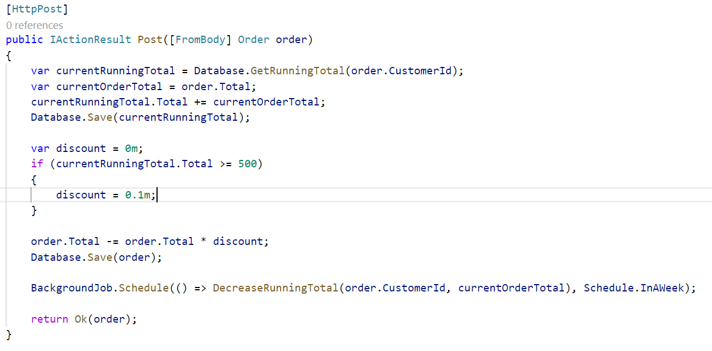

Slide 18
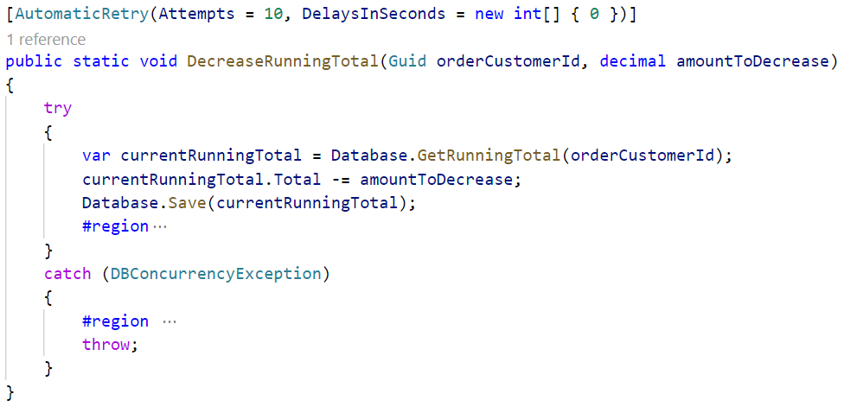

Slide 19
PLACEHOLDER
Notes:
As we could see in the demo while this works nicely and also durably saves running total decreases in hangfire the more orders we get the more we end up overloading an infrastructure which is not really built for this type of activity.
Furthermore because we are directly modifying the running total in the transaction of the controller it is possible that we end up with concurrency conflicts caused either from the customer ordering a lot of stuff or the running total being decreased while we are trying to add the current total of an order to the running total. Now we are forced to add retry patterns to the client calls as well as to the scheduler infrastructure. Given that the scheduler infrastructure is durable that’s fine but the HTTP client calls are not really durable. So we effectively end up building a poor mans queuing infrastructure on top of HTTP in memory with retries.
To make the next step on our programming evolution towards the future we need a different perspective on the problem.

Slide 20
Thanks
Notes:
Thanks

Slide 21
Slides, Links…
github.com/danielmarbach/KnockKnock

Slide 22
Q & A

Slide 23

Software Engineer
Enthusiastic Software Engineer
Microsoft MVP
@danielmarbach
particular.net/blog
planetgeek.ch
Notes:
I’m Daniel, Solution Engineer…
I live in central Switzerland. If you want to know more about me listen to episode 77 of developer on fire
You can reach me on twitter under @danielmarbach
I blog on the particular blog and on my personal blog
I’m the lead behind the asyncification of NServiceBus and the ecosystem around it
I regularly contribute back ideas and code changes to asyncify the .NET OSS libraries and frameworks out there. So far I contributed to Entity Framework, RabbitMQ, Marten, MassTransit, Quartz.NET and many more

Slide 24
Thanks
Notes:
Thank you very much for listening and see you next time

